Slide 1
Porter Creek Secondary
Parent Information Session
for Course Selection

Slide 2
Grade 9 Required Courses
English 9
Mathematics 9
Science 9
Social Studies 9
Physical & Health Education 9
Elective
Elective
Elective
Some post-secondary institutes require a second language at the grade 11 level

Slide 3
Elective Courses 9/10
Technology Education 10: Power Technology, Metal Work, Wood Work
Textiles 10
Visual Arts 10
Computer Studies 10
Robotics 10
Grade 10 course required for graduation
Food Studies 10
French 9 /10
Band 9/10
Drama 10
Athapaskan 9/10
Esthetics 10
Hair Styling 10
Hockey Canada Skills Academy 8/9

Slide 4
SASE 9 Science and Socials Experiential 9
SASE Semester
Science 9
Socials 9
Physical & Health Education 9
Outdoor Education 10
PCSS Semester
Math 9
English 9
Elective/2nd language
Elective

Slide 5
Wood Street Programs Grade 9
MAD Semester 1
PCSS Semester 2
English 9
Socials 9
Physical & Health Ed 9
Drama 9
Math 9
Science 9
Elective/2nd language
Elective

Slide 8
Grade 10 Required Courses
Language Arts 10 Literary Studies and New Media or Composition
Mathematics 10: Foundations of Mathematics and Pre-Calculus or Workplace
Science 10
Social Studies 10
Career & Life Education 10
Physical & Health Education 10

Slide 9
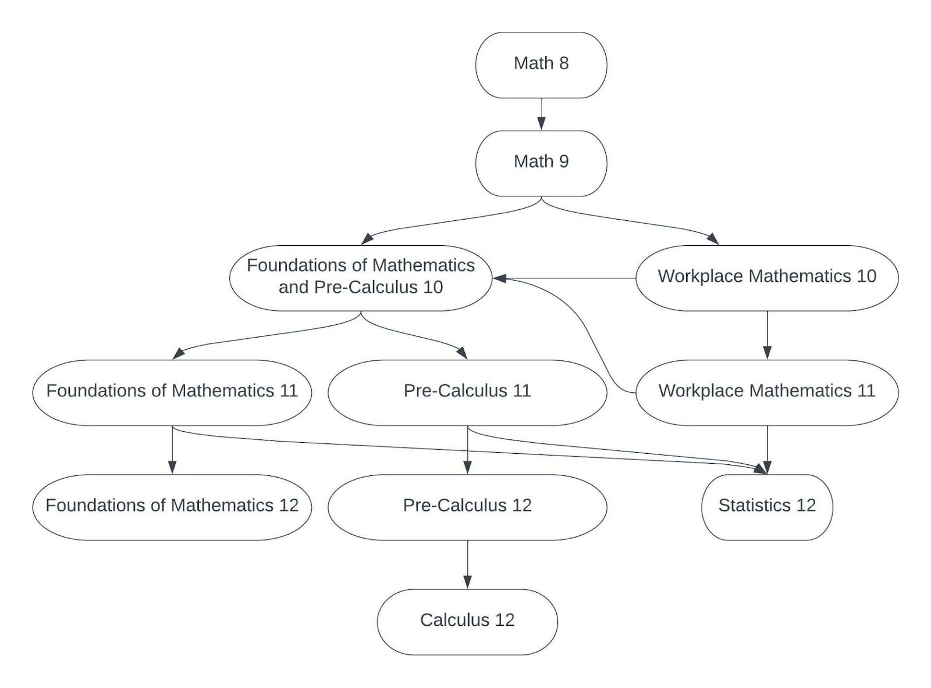
Mathematics Progression

Slide 10
LEAD 10 Leadership, Education, Athlete Development 10
LEAD Semester
Alternate Semester
Morning LEAD Program
Physical Education 10
Fitness & Conditioning 11
Afternoon Classes @ PCSS including 2 required Grade 10 courses, preferably 2 academic.
3 required Grade 10 courses
Elective

Slide 11
FADS 10 FASHION ART DESIGN SCHOOL
FADS Semester
PCSS Semester
Art Foundations 10
Studio Arts 3D 10
Textiles 10
Socials Studies 10
1 Academic required course
Mathematics 10
Science 10
Career & Life 10
Language Arts 10
PE 10

Slide 12
Wood Street Programs Grade 10
MAD Semester 1
English 10
Social 10
Physical Education 10
Drama 10
CHAOS Semester 1
Socials 10
English First Peoples 10
Ancestral Technology 10
Outdoor Education/PE 10
ACES Semester 2
Science 10
Socials 10
Physical Education 10
Outdoor Education 10

Slide 13
Grade 11 Required Courses
Language Arts 11 Literary Studies and New Media or Writing – First Peoples English 11
Math 11 one of: Foundations of Mathematics, Pre-Calculus, or Workplace – Statistics 12
Senior Social Studies: one of: Geography 12, Yukon First Nations 12, 20th Century World History , Law 12, Comparative Cultures 12, Philosophy 12, Explorations in Social Studies 11
Science 11 or 12 (one of: Chemistry, Physics, Life Science, Science for Citizens, Anatomy and Physiology 12, Specialized Science 12, Environmental Science 12 through WILD)
Some post-secondary institutes require a second language at the grade 11 level

Slide 14
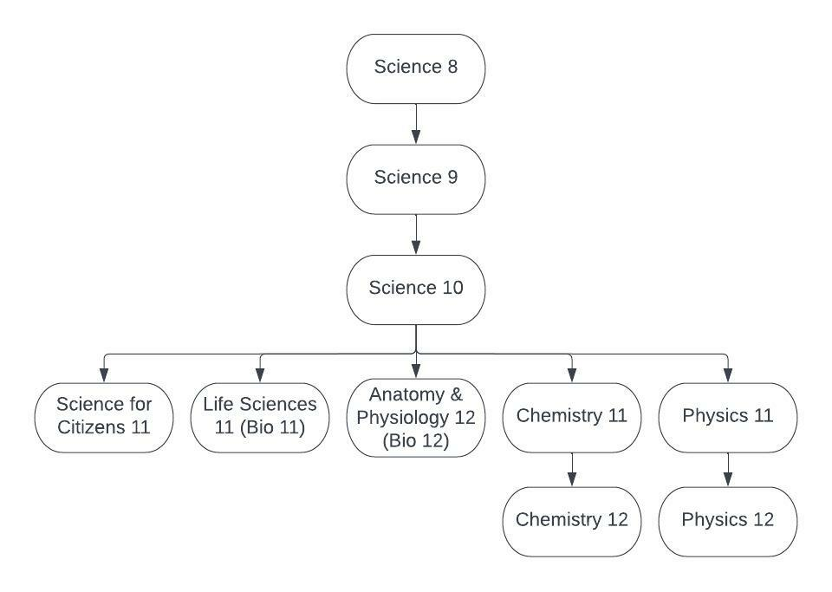
Science Progression

Slide 15
Elective Courses 11/12
Life Science 11
Mathematics 12 (Pre-Calculus, Foundations,
Statistics)
Metal Work 11/12
Music Composition 11/12
Physical Education 11/12 (Active Living and
Fitness & Conditioning)
Physics 11/12
Food Studies 11/12
Psychology 12
Robotics 11/12
Science for Citizens 11
Specialized Science 12 – Sport Science
Statistics 12
Textiles 12
Theatre Performance 11/12
20th Century World History 12
Work Experience 12
Youth Work In Trades 11/12
Esthetics 11/12
Anatomy & Physiology 12
Athapaskan 11/12
Art Foundations 11/12
Automotive Technology 11/12
Calculus 12
Woodwork 11/12
Woodcraft 11/12
Chemistry 11/12
Computer Programming 11/12
Computer Info Systems 11/12
Comparative Civilizations 12
Creative Writing 12
Digital Media 12
French 11/12
Geography (Physical) 12
Hair Styling 11/12
Instrumental Concert Band 11/12
Law 12

Slide 16
WILD 11/12
Alternate Semester 1
WILD Semester 2
Math 11
English 11
Elective
Elective
Geography 12
Environmental Science 12
Outdoor Education 12
Career Life Connections 12

Slide 17
LEAD 11, 12 Leadership, Education, Athlete Development
LEAD Semester
Alternate Semester
Morning LEAD Program
Active Living 11/12
Fitness & Conditioning 11/12
Afternoon Classes @ PCSS
Grade 11, 12 mandatory/elective classes
Grade 11 Required and Elective courses

Slide 18
FADS 11/12 FASHION ART DESIGN SCHOOL 11/12
PCSS Semester 1
FADS Semester 2
Math 11
English 11
Science 11
Elective 11
Art Foundations 11/12
Studio Art 3D 11/12
Textiles 11/12
Senior Social Studies
Grade 11 or 12 Required course

Slide 19
Wood Street Programs Grade 11
Experiential Science 11
Semester 1 or 2
MAD Semester 2
Life Science 11
Chemistry 11
Physical Geography 12
Active Living PE 11
Fine Arts 11 (2 credits)
Language Arts 11
Senior Social Studies
Drama 11
Fine Art/Applied Skill 11

Slide 20
Grade 12 Required Courses
Language Arts 12 English Studies 12
Career Life Connections 12
Grade 12 Course
Grade 12 Course
Grade 12 Course

Slide 21
Courses to Consider for Post-Secondary Admission Requirements
Most universities in Canada require 3 or 4 academic grade 12 courses in addition to English 12.
Grade 12 academic courses at PCSS
Anatomy & Physiology 12 French 12
Athapaskan 12 Physical Geography 12
Calculus 12 20th Century World History
Chemistry 12 Physics 12
Foundations of Mathematics 12 Pre-Calculus 12
Comparative Cultures 12 Computer Programming 12
Statistics 12 Law12
Yukon First Nations Studies 12 Environmental Science 12
Courses that meet some post-secondary institutes’ admission requirements are: Digital Media 12, Psychology 12, Philosophy 12, Creative Writing 12, Specialized Science 12

Slide 22
MAD 12 MUSIC ART DRAMA 12
PCSS Semester 1
MAD Semester 2
Carrer Life Connections 12
Courses Required to Graduate
Language Arts 12
Drama 12
Fine Arts/Applied Skills 12
Fine Arts/Applied Skills 12

Slide 23
External Credits
Athlete 10, 11 & 12
Royal Conservatory Music 10, 11 & 12
Lifesaving 11 & 12
Driver’s Education
Open Water Diving
Pilot’s Licence
Coaching
Officiating
Explore Program
Duke of Edinburgh
4H
And many more ….
Provide documentation to your school counsellor.
BC External Credentials

Slide 24
Dual Credit
take courses at YukonU and earn credit at the post-secondary level and the high school level.
Yukon government pays the tuition.
Academic or trades options
pcssrams.ca

